Slide 1




Weekly report: Storage System
9th week – 10th Presentation
Date: 25 /11/2025
Supervisor: Dr. Laurence Alhrshy
Presented by :Mohamed Ahmed
25/11/2025
Mohamed Ahmed
Storage System Team/ Optimus Syria

Slide 2
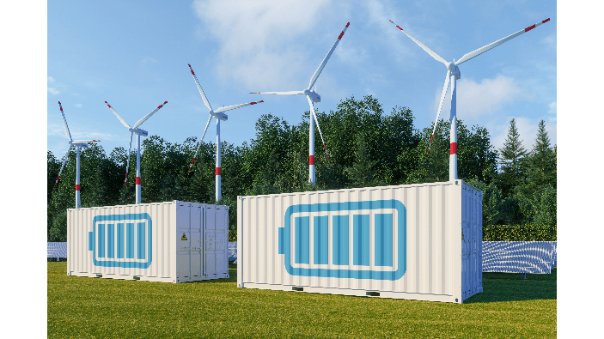
Content
Application Scenarios of Energy Storage
Benefits from Energy Storage
Energy Storage Simulation Workflow
References
avaada.com/advantages-of-wind-energy/
25/11/2025
2
Mohamed Ahmed
Storage System Team/ Optimus Syria

Slide 3
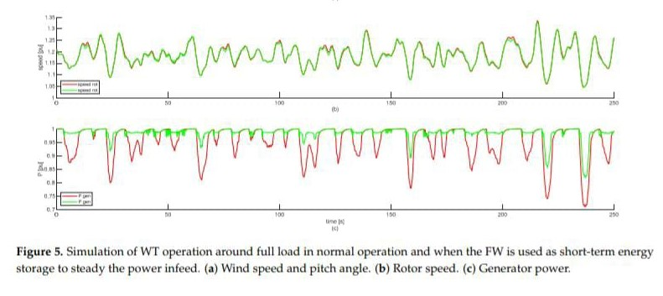
Application Scenarios of Energy Storage
Steadying Power Infeed.
Fast Frequency Response (FFR).
Synthetic / Continuous Inertia Provision.
Low Voltage Ride Through (LVRT).
Power System Stabilization (PSS).
Reduction of Mechanical Loads & Stress.
Support for Emergency Braking & Ramp Control.
25/11/2025
Mohamed Ahmed
Storage System Team/ Optimus Syria

Slide 4
Benefits from Energy Storage
More stable and reliable electricity
Fewer blackouts and faster frequency recovery
Cheaper energy in the long term
More renewable energy penetration
25/11/2025
Mohamed Ahmed
Storage System Team/ Optimus Syria

Slide 5
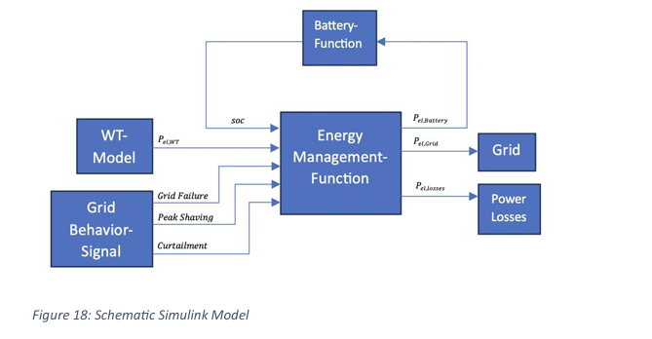
Energy Storage Simulation Workflow
  The model represents a coordinated Energy Management System for a wind-battery-grid configuration.
  It simulates the overall control strategy for managing generated wind power.
  Power flow decisions are made based on real-time system conditions.
  The system integrates wind generation, grid behavior, and battery state into a unified control framework.
  A central control logic dynamically regulates power allocation.
Source: Own creation
25/11/2025
Mohamed Ahmed
Storage System Team/ Optimus Syria

Slide 6
Energy Storage Simulation Workflow
  The model ensures intelligent routing of energy between storage and grid.
  Operational constraints and grid requirements are continuously considered.
  The system enhances reliability and operational flexibility.
  Energy efficiency is maximized while preventing overcharging or grid instability.
  The model reflects realistic smart-grid energy management behavior
Source: Own creation
25/11/2025
Mohamed Ahmed
Storage System Team/ Optimus Syria

Slide 7
Next Presentation
Cable Calculations
Converter Calculations
25/11/2025
7
Mohamed Ahmed
Storage System Team/ Optimus Syria

Slide 8
References
https://www.osti.gov/biblio/1847886
https://www.nrel.gov/docs/fy21osti/78347.pdf
https://www.mdpi.com/1996-1073/14/9/2556?utm_source
25/11/2025
Mohamed Ahmed
Storage System Team/ Optimus Syria
Notes:
Future works ??

